Slide 1




HOPE TO SKILL
Lecture 30
Autoencoders
In Deep Learning
Artificial Intelligence Advance Course

Slide 2


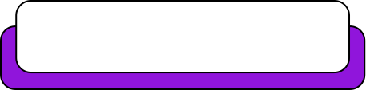
Dedicated to my late Teacher, a beacon of Knowledge.
Your Guidance shaped me; now I shape others through
a free course.
YOUR LEGACY LIVES ON!

Slide 3




AI INSTRUCTORS
Dr.Irfan Malik
Dr.Sheraz Naseer
Dr.Shazia Saqib
M.Haris Tariq

Slide 4


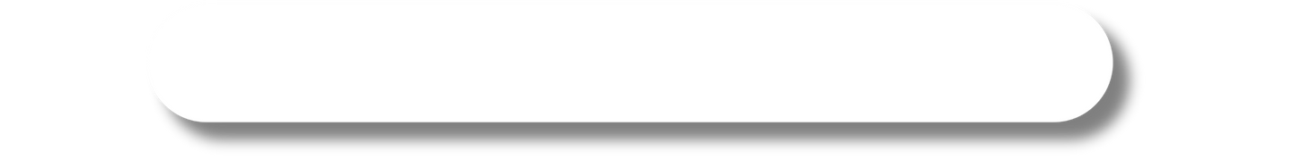
Previous Lecture Topics
01
Applications of CNN
02
Autoencoders
03
Encoder
04
Decoder
05
Anatomy of an Autoencoder

Slide 5
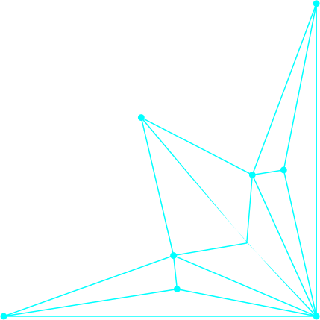
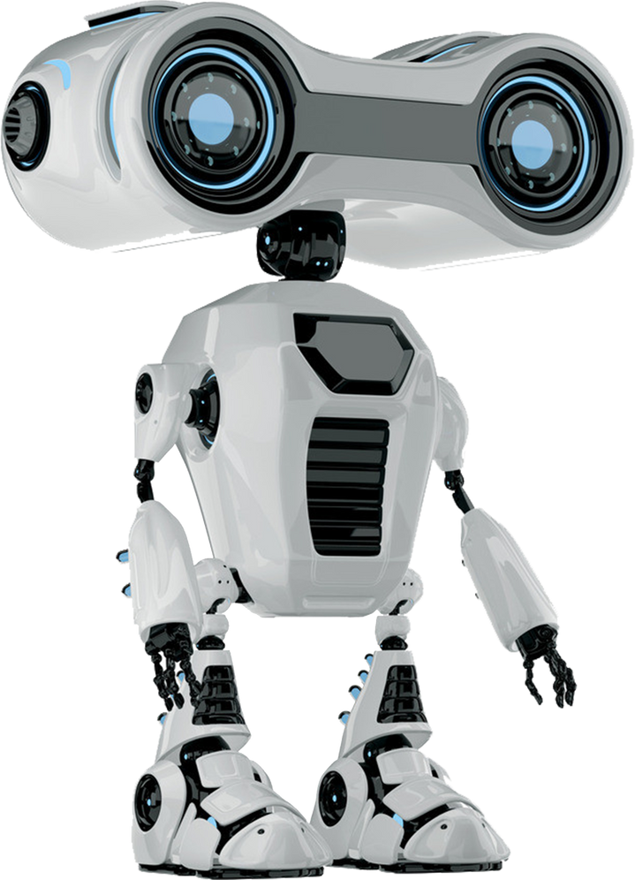

Outline
Types of Autoencoders
Vanilla Autoencoder
Denoising Autoencoder
Convolutional Autoencoder
Variational Autoencoder (VAE)

Slide 6
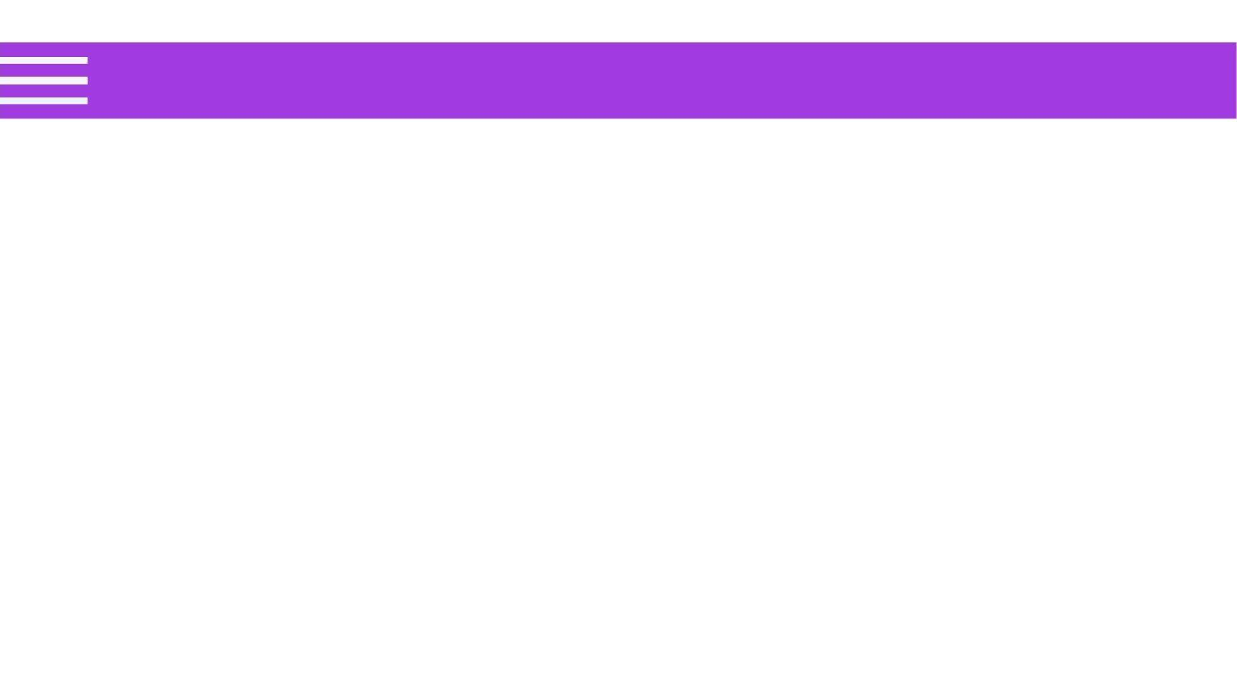
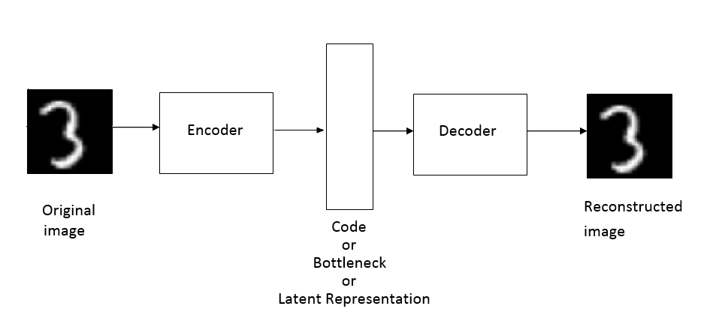
Vanilla Autoencoder
A Vanilla Autoencoder is a type of artificial neural network used to learn efficient codings of input data in an unsupervised manner.

Slide 7
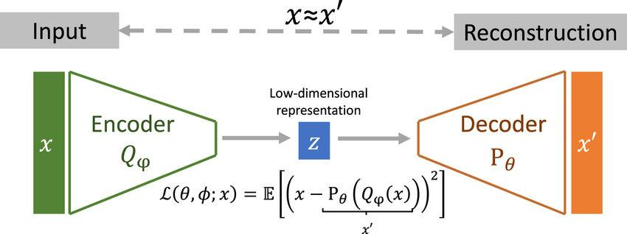
Loss Function
Measures the difference between the input and the reconstructed output, often Mean Squared Error (MSE).

Slide 8
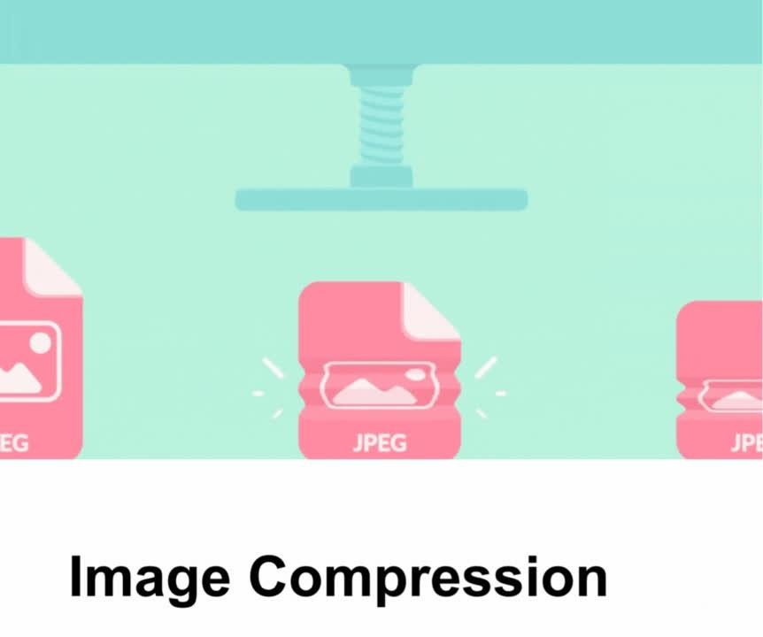

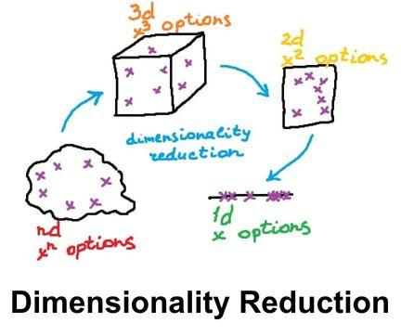
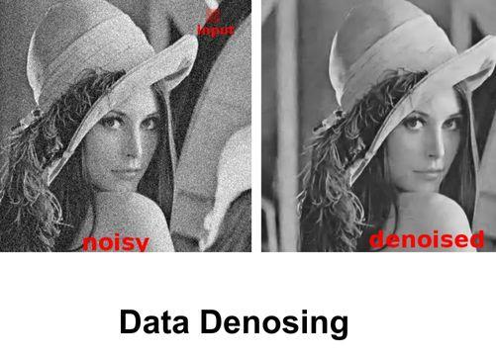
Applications:
Image Compression
Anomaly Detection
Data Denoising
Dimentionality Reduction

Slide 9
Advantages and Limitation
Advantages
Limitations
Simplicity, ability to learn complex patterns, and no need for labeled data.
May not perform well on highly complex data, sensitive to hyperparameter choices, and prone to overfitting without regularization

Slide 10
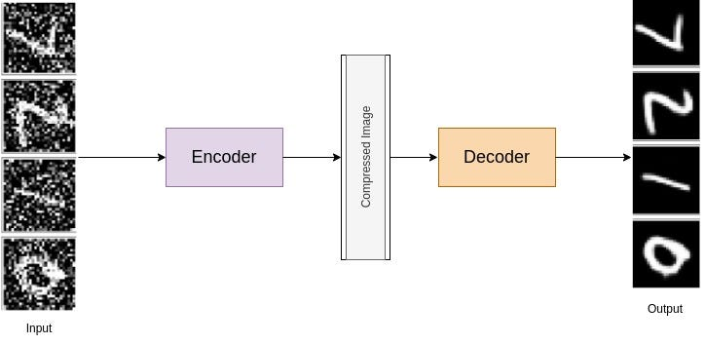
Denoising Autoencoder
A Denoising Autoencoder removes noise from data by learning a robust representation. During training, the input data is corrupted with noise, but the target remains the original, uncorrupted data.

Slide 11
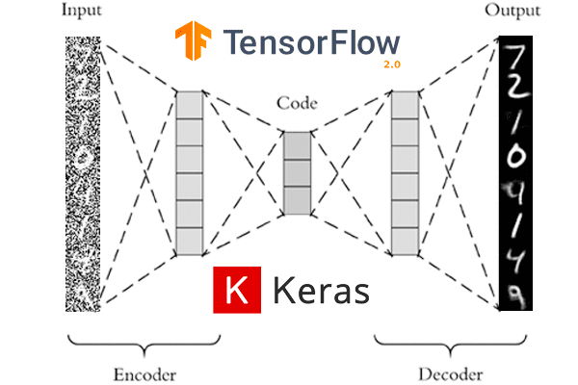
Structure

Slide 12
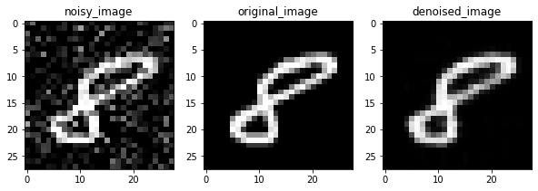
Training Process:
Input Corruption: Random noise is added to the input data.
Reconstruction: The autoencoder is trained to reconstruct the original, noise-free data from the corrupted input.

Slide 13
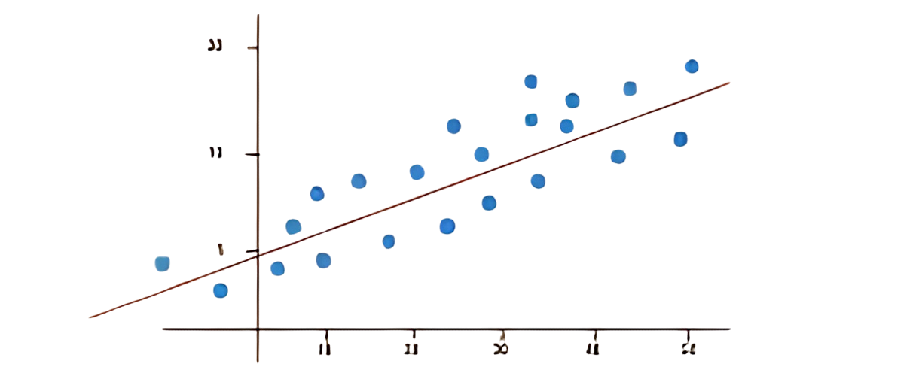
Loss Function
Measures the difference between the original (clean) input and the reconstructed output, often using Mean Squared Error (MSE).

Slide 14
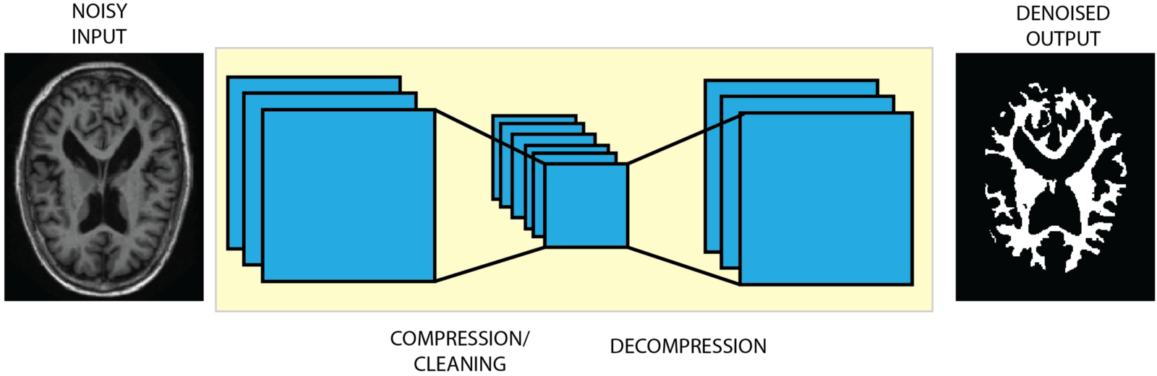
Denoising Autoencoder
Purpose:
Advantages:
To learn to denoise data, enhancing the robustness of the learned features.
Improved feature learning, robustness to noisy data, and better generalization.

Slide 15
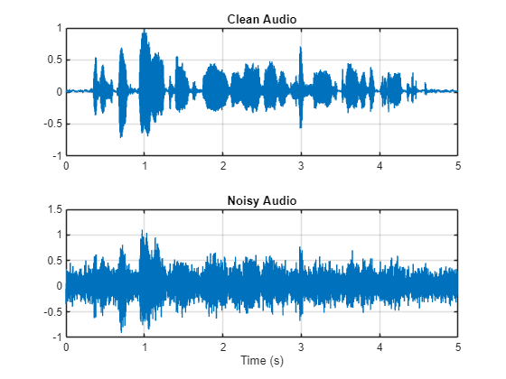
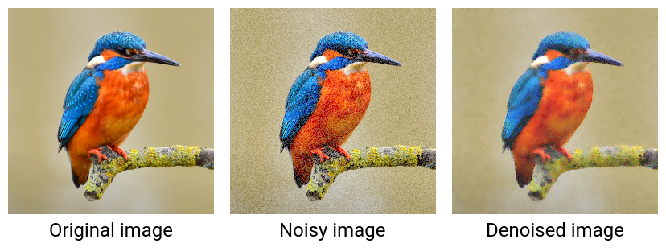
Applications:
Image denoising
Audio denoising
Pre-processing for machine learning tasks.

Slide 16
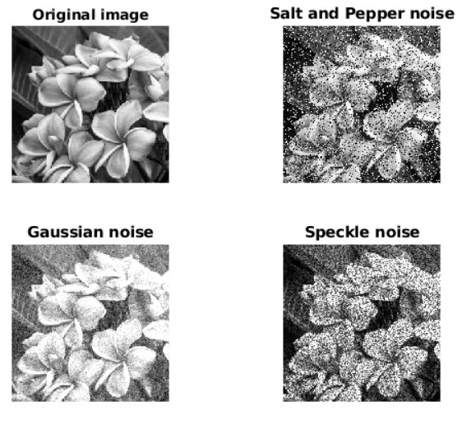
Noise Types
Can include Gaussian noise, salt-and-pepper noise, or any other form of corruption.

Slide 17
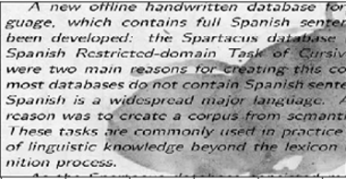
Input Image

Slide 18
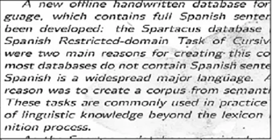
Output Image

Slide 19
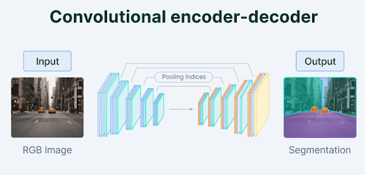
Convolutional Autoencoder (CAE)
A Convolutional Autoencoder (CAE) is a type of autoencoder that uses convolutional layers to learn efficient encodings of image data.

Slide 20
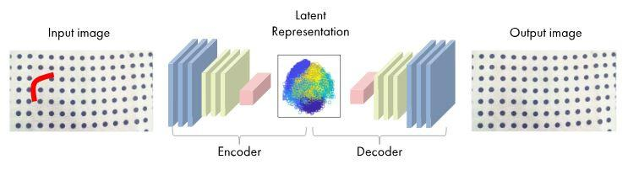
Structure
Encoder: Uses convolutional layers to extract hierarchical features from the input image, reducing its spatial dimensions.

Slide 21
Structure
Latent Space: Encoded representation with reduced dimensions, capturing the essential features of the input image.

Slide 22
Structure
Decoder: Uses transposed convolutional layers (or upsampling) to reconstruct the input image from the latent representation.

Slide 23
A Convolutional Autoencoder (CAE)
Purpose:
Advantages:
To perform tasks such as image compression, denoising, and feature extraction for images
Exploits spatial hierarchies
in images, reduces the
number of parameters,
and improves generalization.

Slide 24
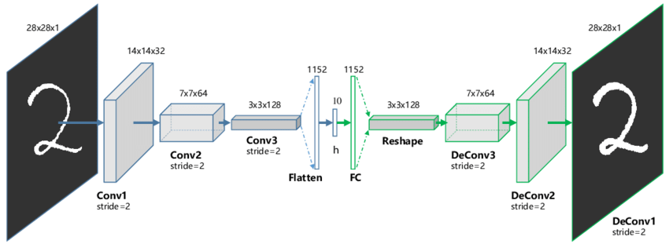
Training
The network is trained to minimize the reconstruction error, often using Mean Squared Error (MSE) as the loss function.

Slide 25
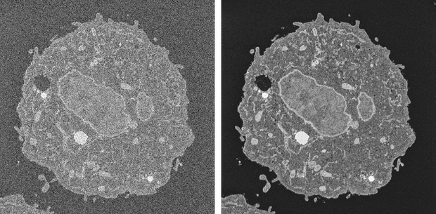
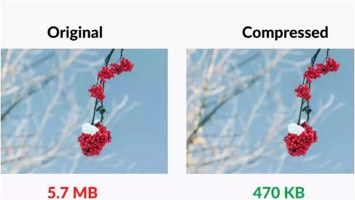
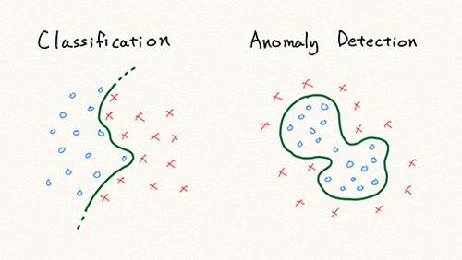
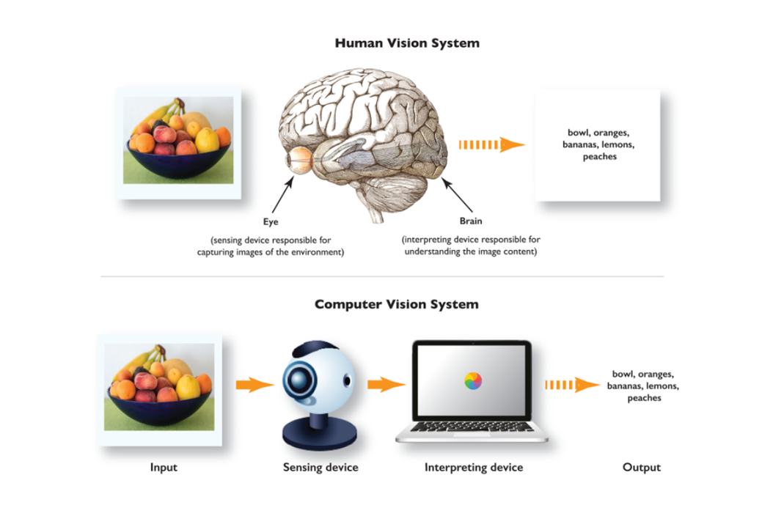
Applications
Image denoising
Image Compression
Anomaly Detection
Pre-processing for other vision tasks.

Slide 26
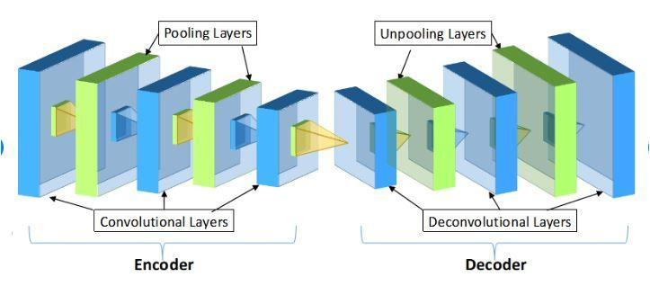
A Convolutional Autoencoder (CAE)
Pooling:
Max-pooling or average-pooling layers
are often used in the encoder to reduce
spatial dimensions.

Slide 27
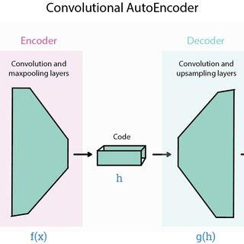
A Convolutional Autoencoder (CAE)
Upsampling:
Transposed convolutions or other upsampling
techniques are used in the decoder to
restore the original dimensions.

Slide 28

A Convolutional Autoencoder (CAE)
Regularization
Hyperparameters
Techniques like dropout and weight decay can be used to prevent overfitting.
Include the number of convolutional layers, filter sizes, stride lengths, learning rate, and number of filters per layer.

Slide 29
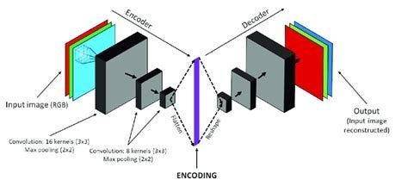
Performance
Effectiveness depends on the architecture, type of convolutional layers, and tuning of hyperparameters.

Slide 30
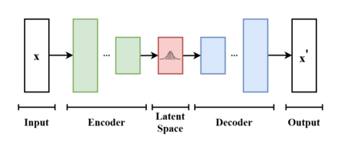
Variational Autoencoder (VAE)
A major issue with regular Auto encoders is that the latent space that the inputs are converted to are discrete (not continuous) and does not allow for an easy interpolation.

Slide 31
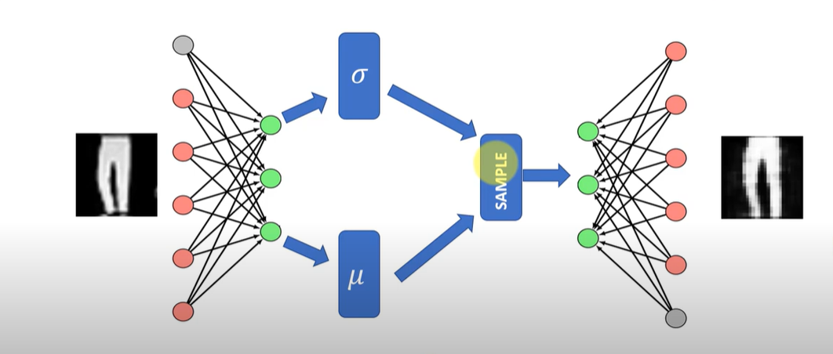
Generative Part of Autoencoder
The generative part of the autoencoder works by randomly picking samples from the latent space

Slide 32
Solving the Issue with VAEs
Variational Autoencoders are here to solve this issue.
They have a continuous latent space by default, making them super powerful in generating new images.

Slide 33
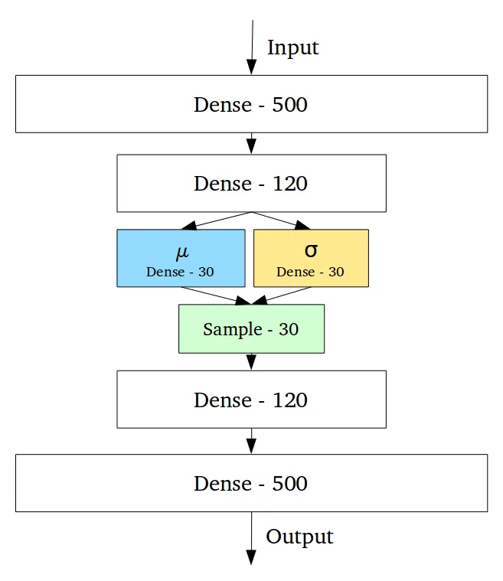
Encoder in VAE
In VAEs, the encoder does not generate a vector of size n but generates two vectors instead:
Vector mean 𝝁
Standard deviations 𝝈

Slide 34
Practical Application of VAE
If you want to apply variational autoencoders to add glasses to a face:
Encode a face with glasses.
Encode a face without glasses.
Subtract the two encoded versions to obtain an encoded version of the glasses alone.
Add this encoded glasses to any face later on.

Slide 35

Applications
VAEs have a wide range of applications, including:
Data Generation: Creating new data samples similar
to the training data.
Representation Learning: Learning compact, meaningful
representations of data.
Anomaly Detection: Identifying unusual data points
by their reconstruction error.

Slide 36
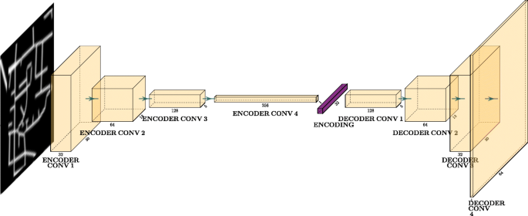
Key Advantages
Smooth Latent Space: The latent space learned by VAEs is continuous and allows for smooth interpolation between data points.
Probabilistic Framework: Provides a principled way to handle uncertainty in the learned representations.

Slide 37

Note:
Autoencoder is an unsupervised learning method if we considered the latent code as the “output”.
Autoencoder is also a self-supervised (self-taught) learning method which is a type of supervised learning where the training labels are determined by the input data.

Slide 38

Previous Lec: 29
click Here
Next Lec:31
click Here
Quiz
click Here

Slide 39


Home Work
In which scenario does a Variational Autoencoder perform better than a Vanilla Autoencoder?

